Slide 1
Mars 2040 Optimization
16.888 Final Presentation
Parker Vascik
Eric Ward
Sam Wald
5/10/2016

Slide 2
Motivation
US Space Policy, NASA’s “Journey to Mars”
Sustainable, indefinite human presence on Mars
Sustainability
Logistics
Economics
Politics
Mars 2040 Project, 2015
Graduate System Design and Management Team
Designed a permanent outpost and support architecture
Determined optimal architecture
Full factorial enumeration
IMLEO metric
16.888 Resupply Optimization
Multi-disciplinary, multi-objective minimization using same models
New objectives account for investment and scientific return

Slide 3

Problem Formulation: Objectives
Objectives
Science Utility
Number of Crew Hours
Location Scientific Quality
Cost
Resupply Cost
Total IMLEO
Development Cost
Transit Propulsion
Notes:
Open Source: opensource.org
Fidelity:

Slide 4
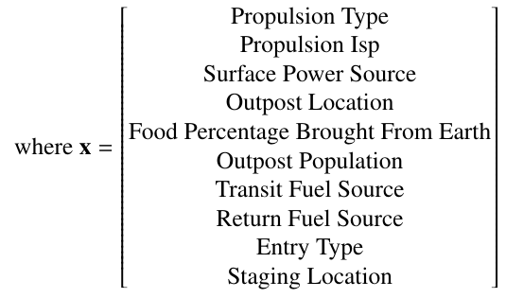
Problem Formulation: Variables
Design Variables
10 Total Variables
8 Discrete Variables
2 Continuous Variables
Propulsion Type, Isp directly effect development cost
Location, Population, and Food directly affect Science Utility
Notes:
Open Source: opensource.org
Fidelity:

Slide 5
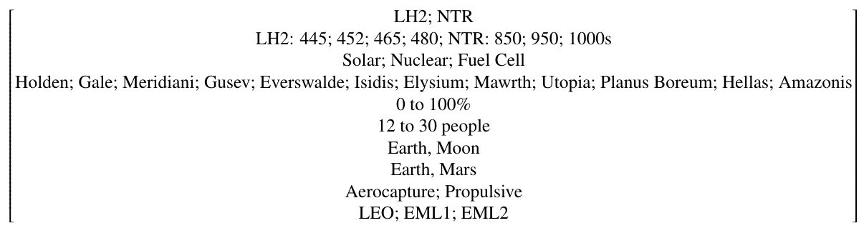
Problem Formulation: Bounds and Constraints
Bounds
Current Mars information
Theoretical limits
Current capabilities
Expected developments
Constraints
Physics-based
Drivers of system sizing
Habitation
Transportation
Power
ISRU
ISFR
Staging
Notes:
Open Source: opensource.org
Fidelity:

Slide 6
Problem Statement
Notes:
Open Source: opensource.org
Fidelity:

Slide 7
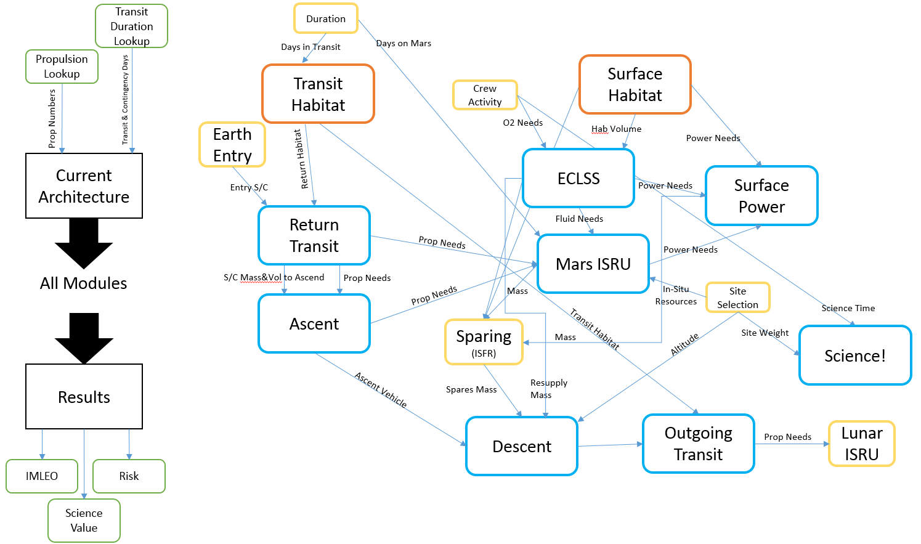
Modeling and Simulation: Modules

Slide 8
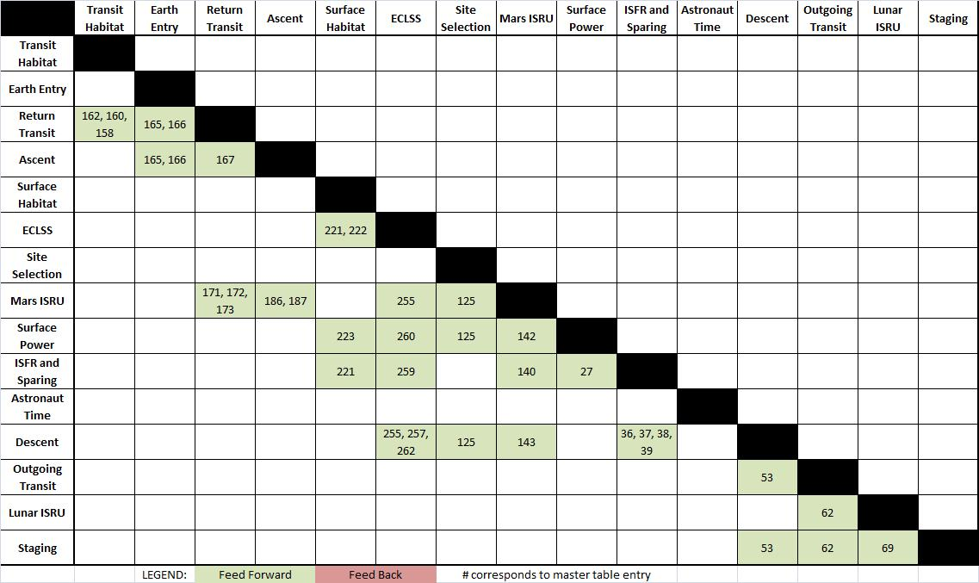
Modeling and Simulation: DSM
Reordered to minimize feedback relationships

Slide 9
Modeling and Simulation: Development Cost

Slide 10
Single Objective Optimization

Slide 11
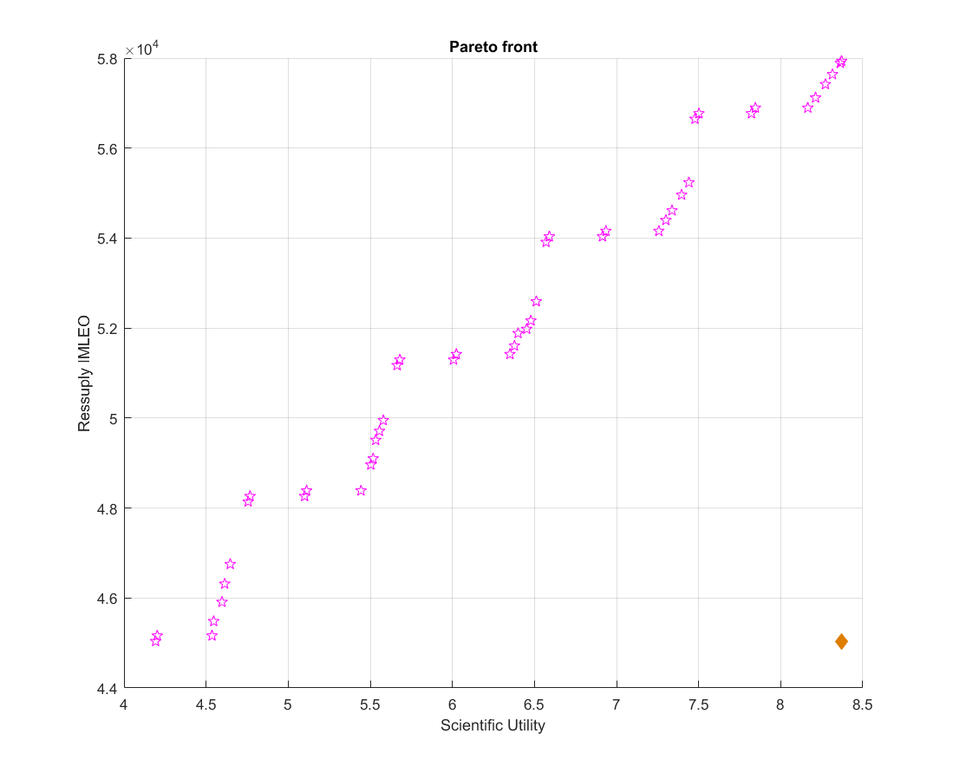
Multi-Objective Optimization

Slide 12
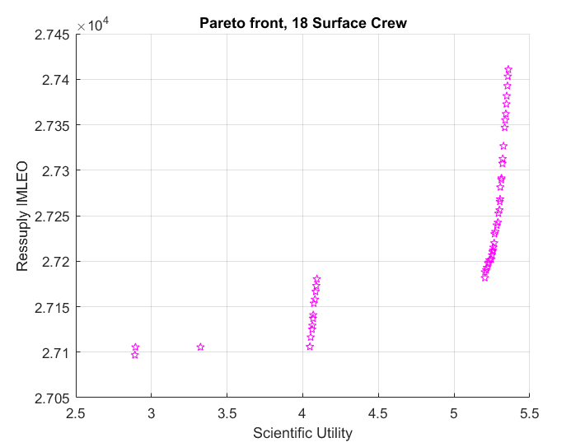
Multi-Objective Optimization

Slide 13
Final Recommendation

Slide 14
Learnings and Future Work

